Slide 1
Our IoT-Based Agriculture Solution Overview
Direct Challenges Addressed
Solution Blueprint
Our solution strategically tackles challenges such as water misuse, inefficient fertilization, and pest control, significantly enhancing overall farm productivity.
Introducing an architecturally sound and technologically advanced system capable of real-time monitoring, data analysis, predictive maintenance, and more.
Our IoT-based agriculture solution integrates sensors, actuators, and data analytics to optimize farming processes. It collects real-time data on soil moisture, temperature, humidity, and light levels, allowing farmers to make informed decisions about irrigation, fertilization, and crop health. Through a user-friendly interface, farmers can remotely monitor field conditions, receive alerts, and automate irrigation systems based on preset thresholds. The solution enhances crop yield, conserves resources, and improves overall farm efficiency, empowering farmers with actionable insights for sustainable agriculture practices.

Slide 2
Highlight Of the Identified Challenges
Our IoT-based agriculture solution directly addresses key challenges faced by farmers:
1. Data-Driven Decision Making: By collecting real-time data on soil conditions, weather patterns, and crop health, farmers can make informed decisions about irrigation, fertilization, and pest management.
2. Resource Conservation: Through precise monitoring and control of irrigation systems, our solution helps conserve water and energy by avoiding overwatering and optimizing resource usage based on actual crop needs.
3. Remote Monitoring and Management: Farmers can remotely monitor field conditions and receive alerts about potential issues such as soil moisture depletion or temperature fluctuations, allowing for timely intervention and problem resolution.
4. Increased Efficiency and Yield: With automated processes and predictive analytics, farmers can optimize their farming practices, leading to increased crop yields, improved quality, and reduced operational costs.
5. Sustainability: By promoting data-driven precision agriculture techniques, our solution supports sustainable farming practices by minimizing environmental impact and maximizing resource efficiency over the long term.

Slide 3
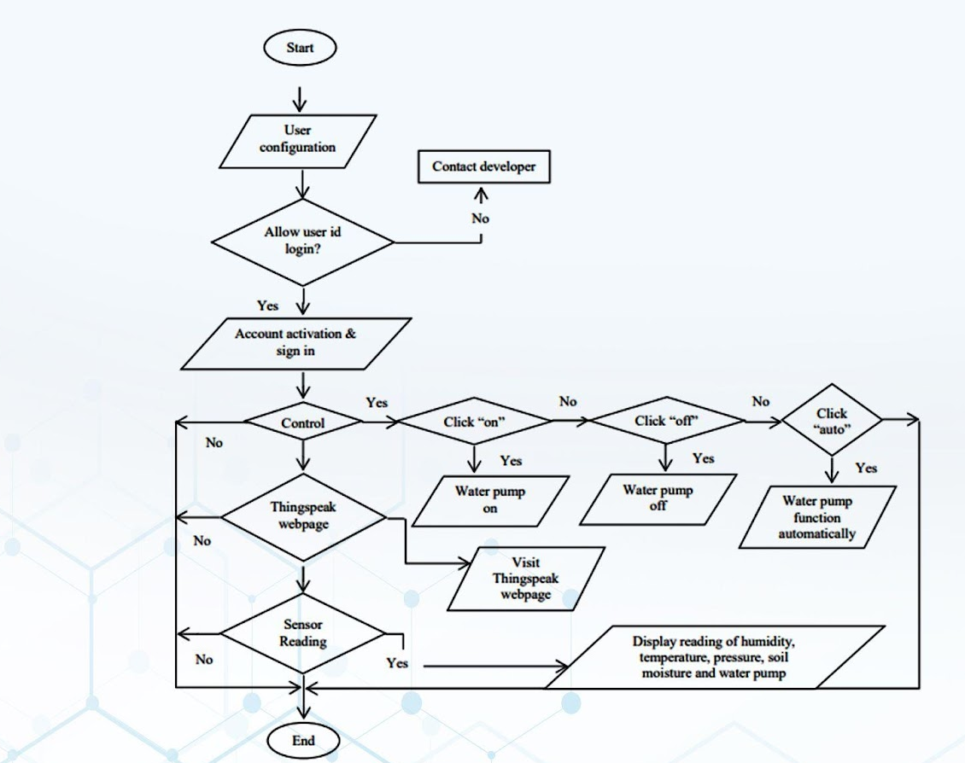
System Architecture

Slide 4
Key Components Breakdown
Components | Description | Price in Rs
Sensors | DHT11 | 200
 | Rain Sensor module | 70
 | LCD Display (2*16) | 100
 | SPST Relay Module | 105
 | ESP32 | 350
 | Moisture Sensor | 50
 | PIR Motion Sensor | 60
 | Dc motor 12V | 120
 | Water pump | 200
 | Buzzer | 20

Slide 5
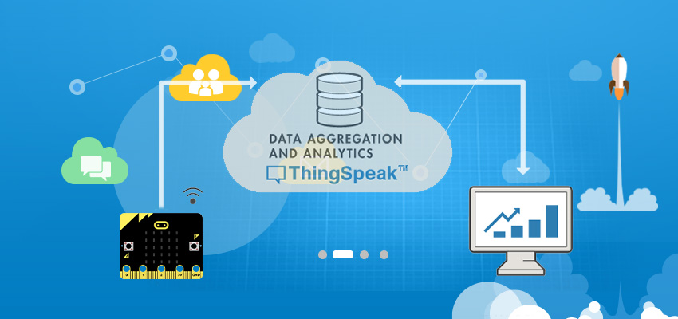
Data Analytics Platform
ThingSpeak
ThingSpeak is an Internet of Things (IoT) platform that enables users to collect, analyze, and visualize data from sensors or devices.
It provides cloud-based storage for time-series data, offering RESTful APIs for easy integration with IoT devices and applications.
With built-in MATLAB analytics capabilities, users can perform complex data analysis and visualization tasks.
ThingSpeak supports real-time data streaming and allows users to create custom dashboards for monitoring and tracking various IoT metrics.
It's widely used in IoT projects for remote monitoring, environmental sensing, and industrial automation.

Slide 6

User Interface
Arduino Ide
Arduino IDE is an open-source software, designed by Arduino.cc and mainly used for writing, compiling & uploading code to almost all Arduino Modules. It is an official Arduino software, making code compilation too easy that even a common person with no prior technical knowledge can get their feet wet with the learning process

Slide 7
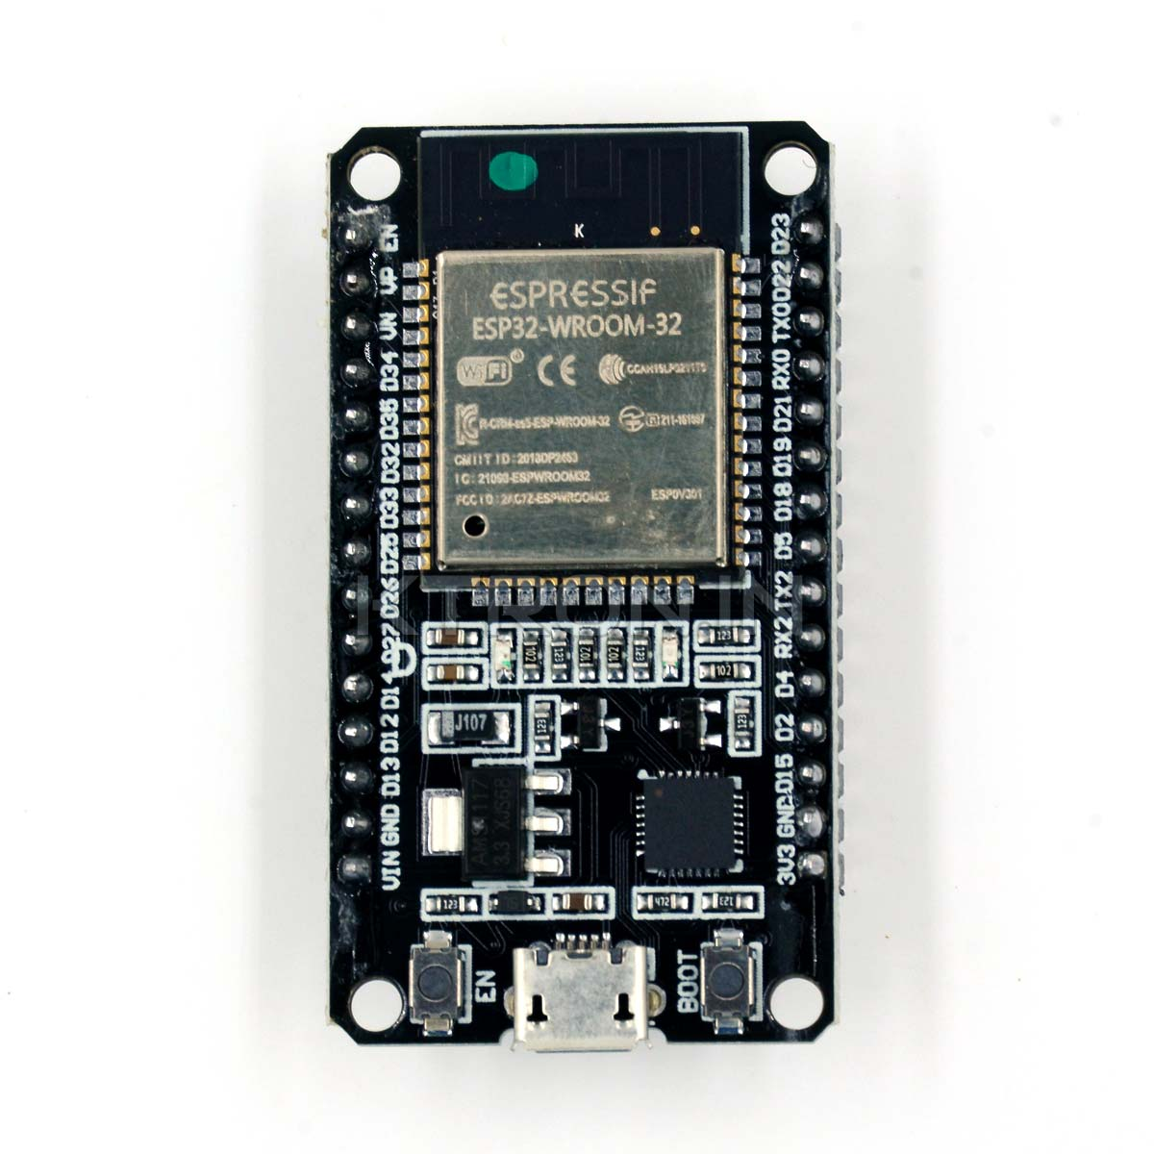
Descriptions of Sensors which are used
1 ESP32
The Node MCU ESP8266 development board comes with the ESP-12E module containing ESP8266 chip having Tensilica Xtensa 32-bit LX106 RISC microprocessor. This microprocessor supports RTOS and operates at 80MHz to160 MHz adjustable clock frequency. Node MCU has 128 KB RAM and 4MB of Flash memory to store data and programs. Its high processing power with in-built Wi-Fi / Bluetooth and Deep Sleep Operating features make it ideal for IOT projects.

Slide 8
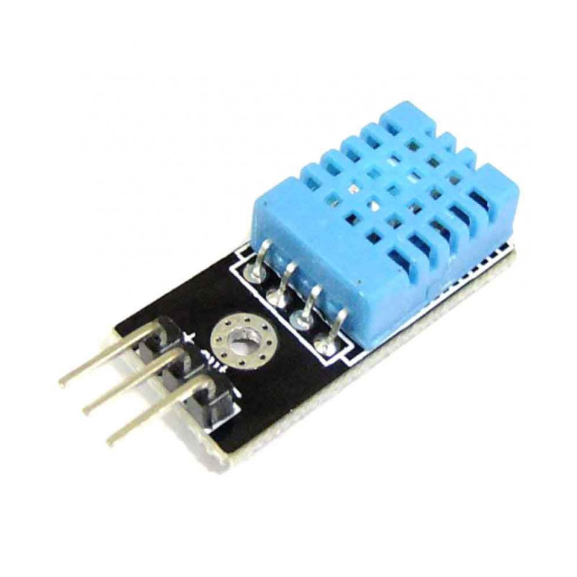
2 DHT11
The DHT11 is a commonly used Temperature and humidity sensor. The sensor comes with a dedicated NTC to measure temperature and an 8-bit microcontroller to output the values of temperature and humidity as serial data. The sensor is also factory calibrated and hence easy to interface with other microcontrollers. The sensor can measure temperature from 0°C to 50°C and humidity from 20% to 90%with an accuracy of ±1°C and ±1%.

Slide 9
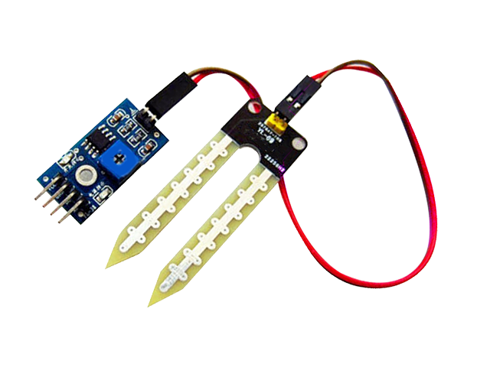
3 Soil Moisture Sensor
The soil moisture sensor is one kind of sensor used to gauge the volumetric content of water within the soil. As the straight gravimetric dimension of soil moisture needs eliminating, drying, as well as sample weighting. These sensors measure the volumetric water content not directly with the help of some other rules of soil like dielectric constant, electrical resistance, otherwise interaction with neutrons, and replacement of the moisture content.

Slide 10
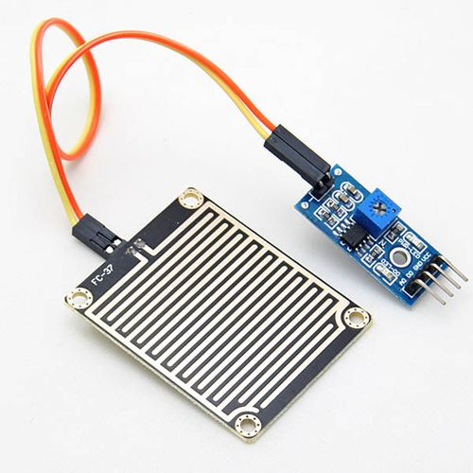
4 Rain Sensor
A rain sensor is a device that detects rainfall and triggers automated responses. It typically employs a series of electrodes or a moisture-sensitive element to detect the presence of water. When rain is detected, it sends a signal to systems like irrigation controllers to pause watering, enhancing water conservation efforts. Rain sensors are commonly used in both residential and commercial settings to optimize outdoor water usage.

Slide 11
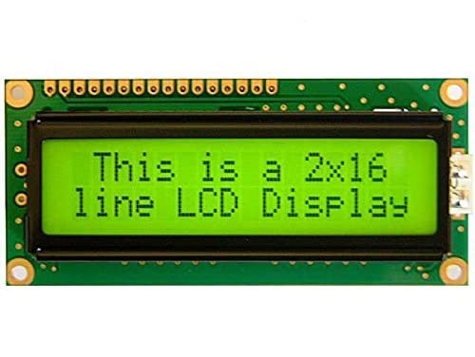
5 LCD Display (2* 16)
An LCD display 16x2 is a liquid crystal display with 16 characters in each of its two rows. It provides a compact yet informative output for various electronic projects and devices. These displays are commonly used in Arduino and Raspberry Pi projects for showing text-based information such as sensor readings, messages, or menu options. With its simplicity and versatility, it serves as a fundamental component in many embedded systems and DIY electronics.

Slide 12
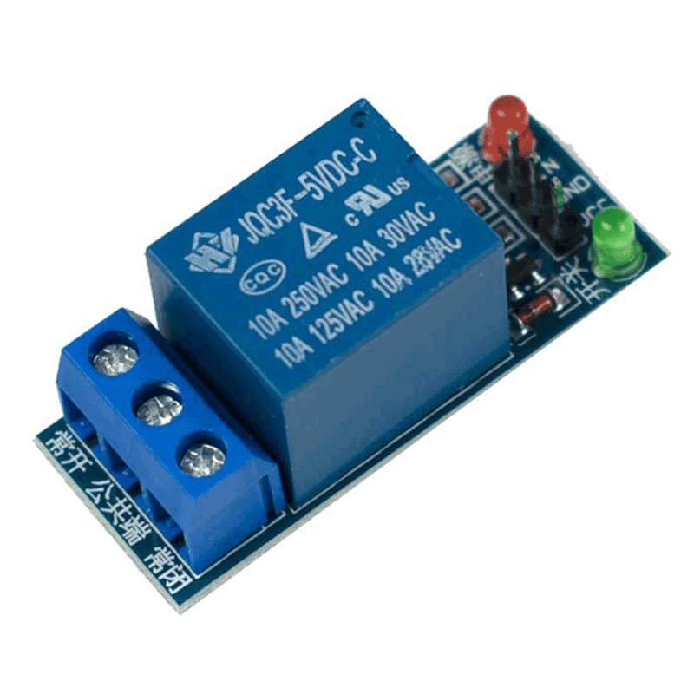
6 SPST Relay Module
Relay is an electromechanical device that uses an electric current to open or close the contacts of a switch. The single channel relay module is much more than just a plain relay, it comprises of components that make switching and connection easier and act as indicators to show if the module is powered and if the relay is active or not.

Slide 13
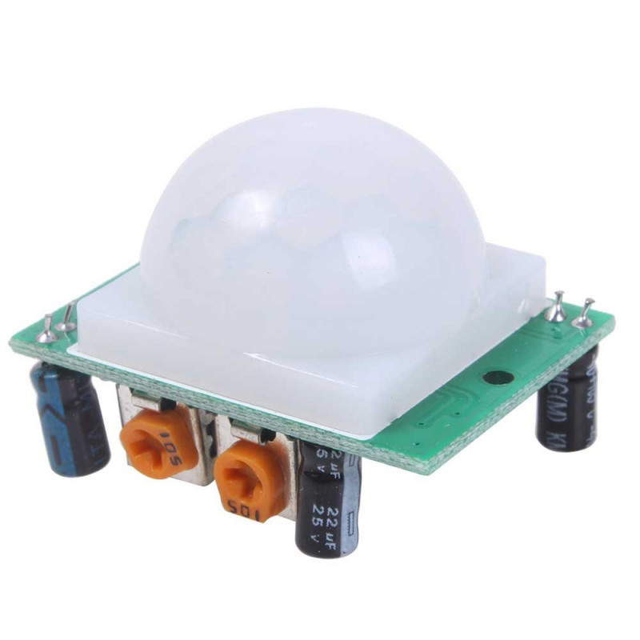
7 PIR Motion Sensor
The PIR sensor itself has two slots in it, each slot is made of a special material that is sensitive to IR. The lens used here is not really doing much and so we see that the two slots can 'see' out past some distance (basically the sensitivity of the sensor).When the sensor is idle, both slots detect the same amount of IR, the ambient amount radiated from the room or walls or outdoors. When a warm body like a human or animal passes by, it first intercepts one half of the PIR sensor, which causes a positive differential change between the two halves. When the warm body leaves the sensing area, the reverse happens, whereby the sensor generates a negative differential change.

Slide 14
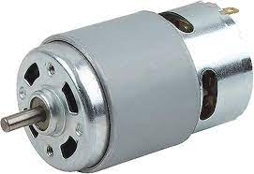
8 DC Motor 12V
A 12V DC motor is an electric motor designed to operate on a 12-volt direct current power supply. It converts electrical energy into mechanical energy to produce rotational motion. These motors are widely used in various applications including robotics, automotive systems, home appliances, and industrial machinery. Their voltage rating determines their speed, torque, and power characteristics, making them suitable for a range of tasks from precise control to high-power output.

Slide 15
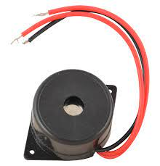
9 Buzzer
A buzzer is an electromechanical device that produces sound when an electrical current passes through it. It typically consists of a coil of wire and a vibrating diaphragm or a piezoelectric element. Buzzer's sound output can vary in pitch and intensity depending on its design and input voltage. Commonly used in alarms, timers, and electronic notification systems, buzzers provide audible alerts and signals in various applications.

Slide 16
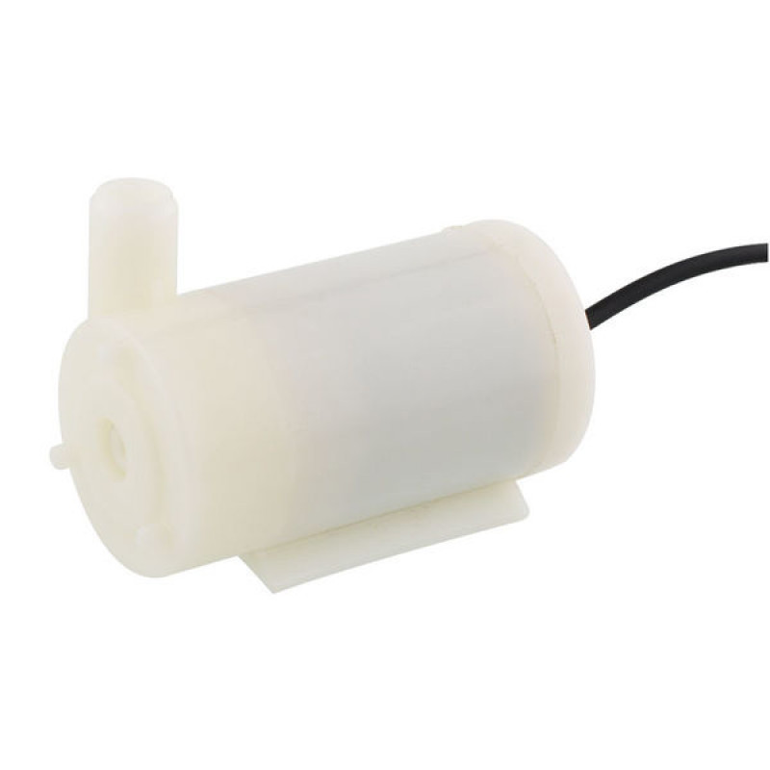
10 Water Pump
A water pump is a mechanical device used to move water from one location to another. It typically operates by creating suction or pressure to draw water through a pipe or hose. Water pumps are utilized in various settings including residential, agricultural, industrial, and commercial applications for irrigation, drainage, circulation, and water supply purposes. They come in different types such as centrifugal, submersible, and diaphragm pumps, each suited to specific needs and environments.

Slide 17
Our Solution in Action
1
Scenario Deployment
Visualizing a day in the life of a farm utilizing our IoT solution, witnessing the tangible benefits and operational ease in real-time.
2
Technical Efficacy
Spotlighting the seamless interplay between sensors, analytics, and action to demonstrate proactive farming at its finest.
3
Animated Insights
An animated journey that captures our IoT solution's dynamics, empowering farmers with revolutionary management capabilities.

